Slide 1


DTAM
August 4, 2022
CONTACT
Energy and Chemical Engineering
1st Engineering Building Room 201
Tel. +82 52 217 3542 Web. http://eche.unist.ac.krAddress

Slide 2

2
CONTENTS
1. Introduction
03
4. Conclusion
21
2. Method
08
3. Evaluation
13

Slide 3
4
Introduction
Feature based SLAM
단점: feature가 없거나 적은 곳에서 위치를 잃어버린다.
Computing power가 좋아졌기 때문에 image를 모두 사용하여서 계산해보자 => photogrammetric 방식 사용

Slide 4
4
Introduction
DTAM: Dense tracking and mapping in Real-time ( PTAM + keyframe selection을 이용)
DTAM is a system for real- time camera tracking and reconstruction which relies not on feature extraction but dense,
every pixel methods.
Simultaneous frame-rate Tracking and Dense Mapping
장점: featureless한 곳에서도 잘 작동 + motion blur가 있는 곳에서도 잘 작동

Slide 5
4
Introduction
PTAM: Parallel Tracking and Mapping
Keyframe을 이용한 visual SLAM
카메라 위치를 추적하는 tracking 부분과 특징 맵을 생성하는
mapping 부분을 서로 분리시켜 별도의 thread로 parallel하게 돌린다.
핵심 idea: 비교적 연산 로드가 적은 카메라 tracking은 모든 영상 frame에 적용하여 실시간성을 추구하고, 맵 갱신은 주요 키프레임에만 적용하되 시간이 오래 걸리더라도 정밀한 알고리즘을 사용

Slide 6
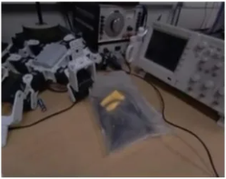
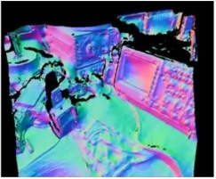
4
Introduction
System Overview
Input image
Input: Single hand held RGB Camera
Objective: Dense Mapping, Dense Tracking
3D dense map

Slide 7
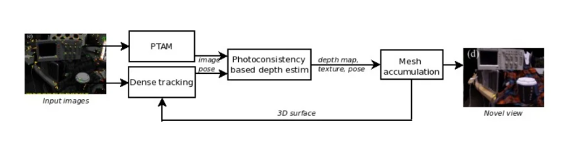
4
Introduction
System Overview

Slide 8
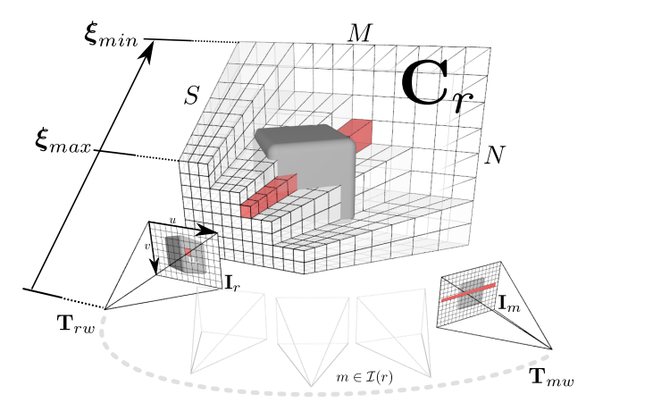
4
Dense mapping
Estimate inverse depth map from bundles of images

Slide 9

4
Dense mapping
Total Cost
Photometric error
K: intrinsic matrix
Tmr: transformation from m to r

Slide 10

4
Depth map estimation
Principle:
-S depth hypothesis are considered for each pixel of the reference image Ir
-Each corresponding 3D point is projected onto a bundle of images Im
-Keep the depth hypothesis that best respects the color consistency from the reference to the bundle of images
Formulation:

Slide 11

4
Inverse Depth Map Computation
Inverse depth map can be computed by minimizing the photometric error

Slide 12
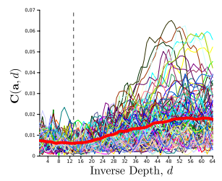
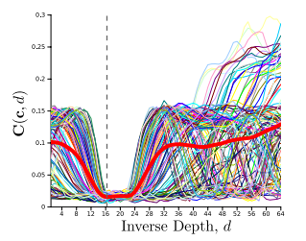
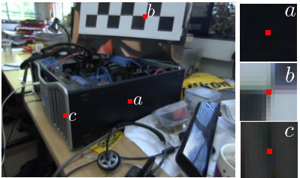
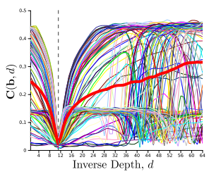
4
Inverse Depth Map Computation

Slide 13
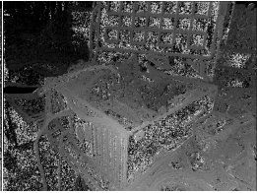
4
Depth map filtering approach
Problem: Uniform regions in reference image do not give discriminative enough photometric error
Solution: Regularization term
We want to penalize deviation from spatially smooth solution
But preserve edges and discontinuities

Slide 14

4
Depth map filtering approach
First term: regularization constraint, g is defined as 0 for image gradients and 1 for uniform regions.
So that gradient on depth map is penalized for uniform regions.
Second term: data term defined by photometric error
Huber norm: differentiable replacement to L1 norm that better preserve discontinuities compared to L2

Slide 15


4
Depth map filtering approach

Slide 16
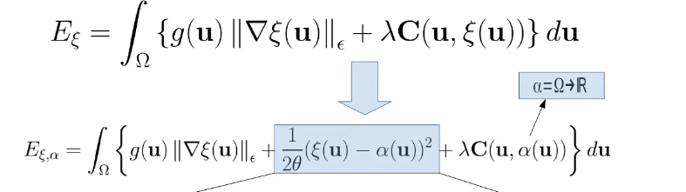
4
Depth map filtering approach
Point wise optimisable

Slide 17
4
Depth map filtering approach
Problem
Optimization badly conditioned as uniform regions
Expensive when doing exhaustive search
Accuracy is not good enough
Solutions
Primal- dual approach for convex optimization
Acceleration of non-convex search
sub-pixel accuracy

Slide 18
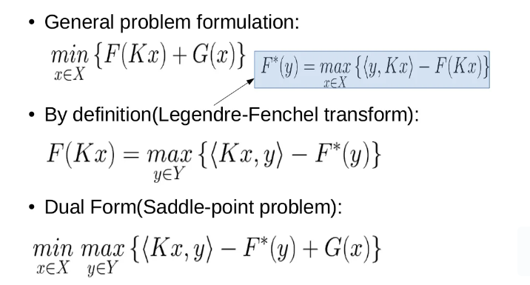
4
Primal-Dual Approach
General Problem formulation:

Slide 19
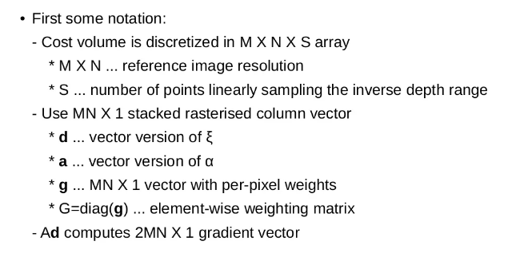
4
DIscretisation

Slide 20

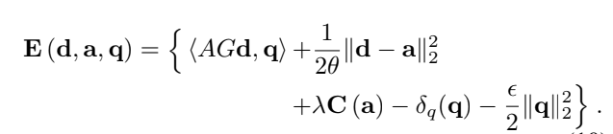
4
adjustment

Slide 21
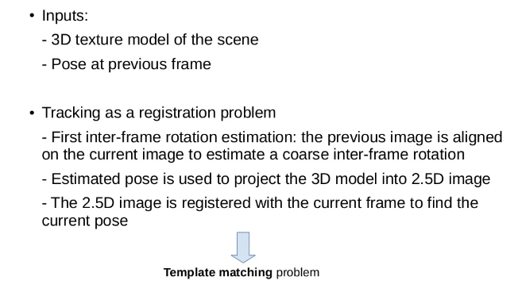
4
Dense Tracking

Slide 22
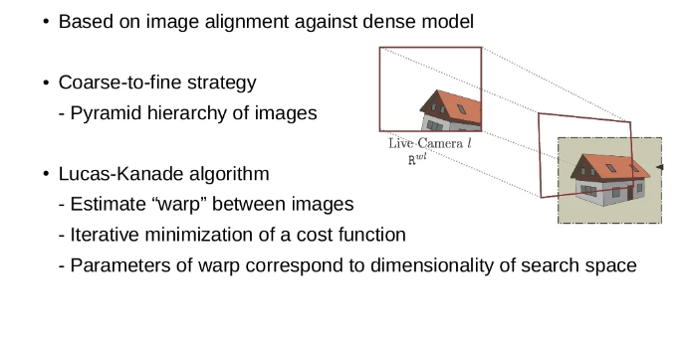
4
Tracking Strategy and Algorithm

Slide 23
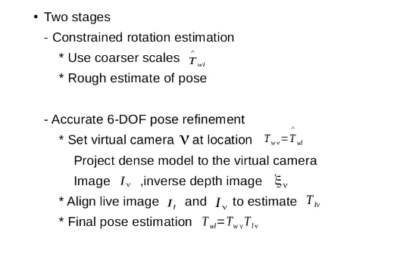
4
Tracking in Two Stages

Slide 24
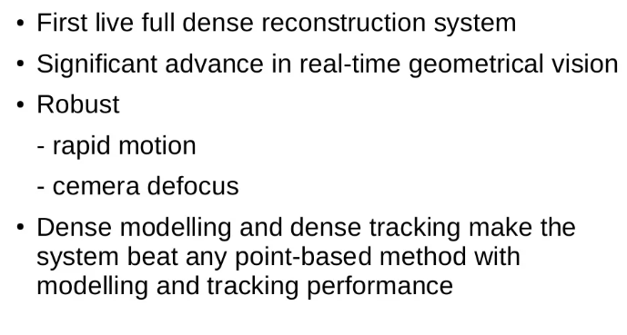
4
Conclusion

Slide 25
THANK YOU

